Slide 1
Digital Clubcard Project – Czech/Slovak
MCA Introduction 23rd Jan 2014
Mrinal Chakraborty

Slide 2
Agenda
What is MCA
Sitemap and Impacted Process
New and Impacted Capabilities
Online Demo for MCA
Customer Journey and Where MCA should sit
Stakeholders involved
Deep dive Topics (Need Detailed Sessions*)
Project Timelines (CZ and SK)
Business and IT related Milestones
Testing strategy

Slide 3
MCA – What is it ?
My Clubcard Account (MCA) is an online view of a Customer’s Clubcard account. It’s a great tool for tracking with how their points are progressing and keeping their details up to date.
CUSTOMERS CAN:
Change their personal details
Review their Clubcard points balance (Customers can view points collected in the past XX statements as well as their transaction details)
View which Clubcard vouchers & coupons they have available to use (only those issued from XY) – once Customer used them these will appear in used coupons / vouchers section
Print their Clubcard vouchers & coupons at home on their printer (only those issued from XY) and then use in store
WHAT YOU SHOULD BENEFIT FROM WITH MCA LAUNCH:
Reduced number of Calls
Correct Customer data
Customers feel more interactive with the scheme
Personalization

Slide 4
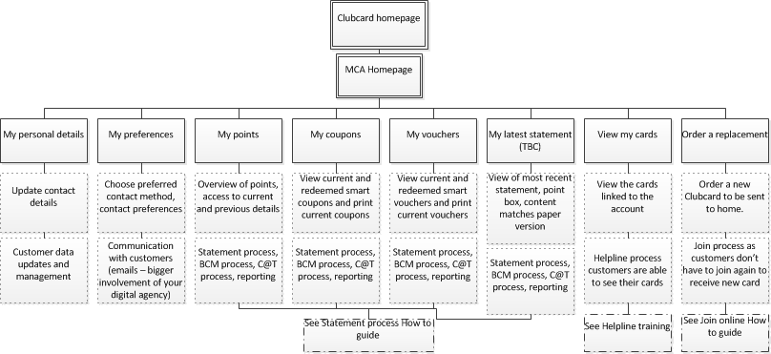
MCA Site Map and Impacted Processes
MCA SITE
Content
Process Impacted
UK has Christmas savers as a scheme, Visible in MCA , we do not have the same mechanics for Group ,
more information
http://www.tesco.com/clubcard/christmas-savers/

Slide 5
New and impacted capabilities
Capabilities | Overview
Join Process | Online Avenue, Replacement Cards, more information in “join in store and online guide”**
Managing Account | Customers now enabled to managed their own account /update information by themselves as-to the current of getting that done via helpline
Print @ home | Customers can download their Clubcard / Coupons / Vouchers from MCA as many times as needed. Process Related to “Reissue” is now enhanced
Communication with Customers | Communication is more digital , MCA Needs to be added to all clubcard materials (Hard/ Soft/ Stores/ Online)
Statement Processes | Smart coupons & Vouchers , Points details , transactions all are visible to customers
Helpline Processes | Additional Set of Queries for Helpline, effect to the new and changed Process , more details in the helpline training guide
Store Processes | Stores would have to updated on the new functionality**
Reporting | New issuance channel for coupon and vouchers

Slide 6
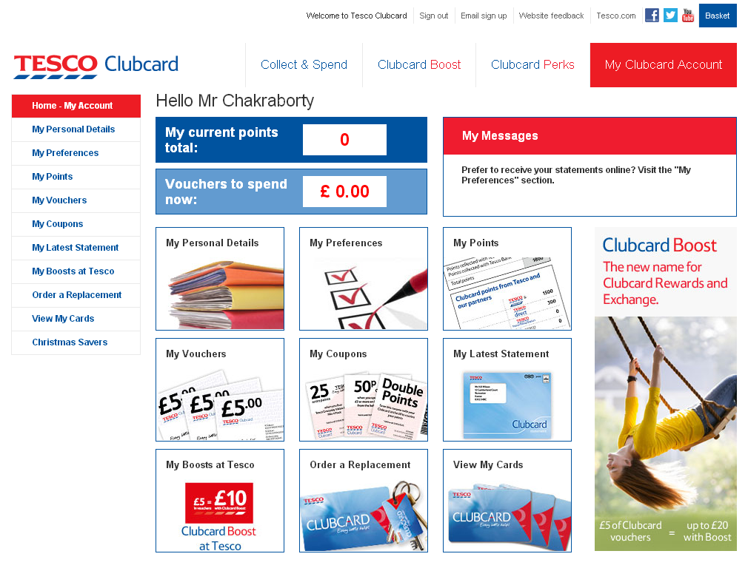
MCA – The Home Page
Not in Scope for Group
?
Online Demo for MCA

Slide 7
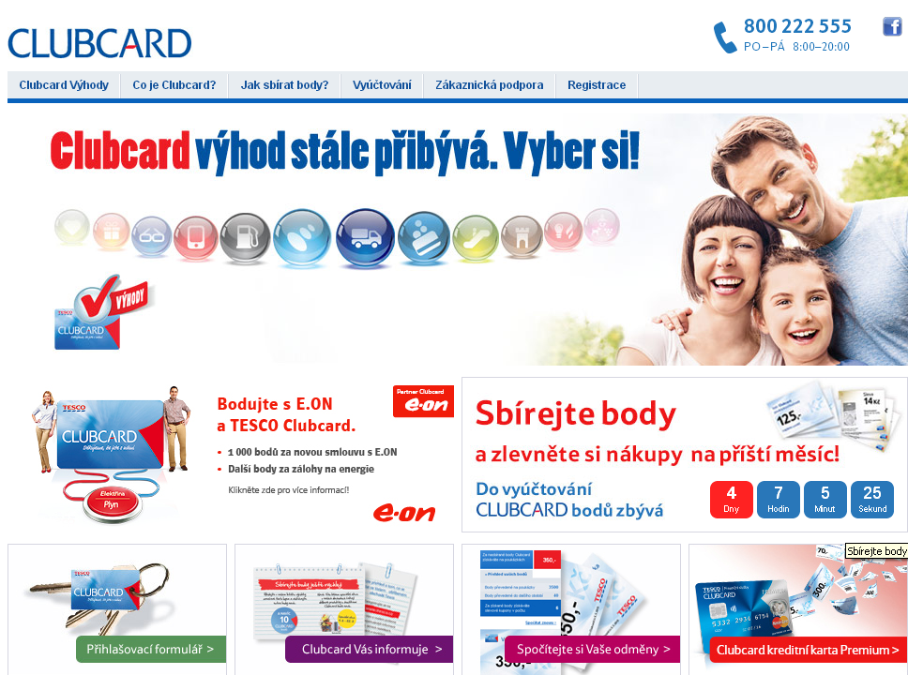
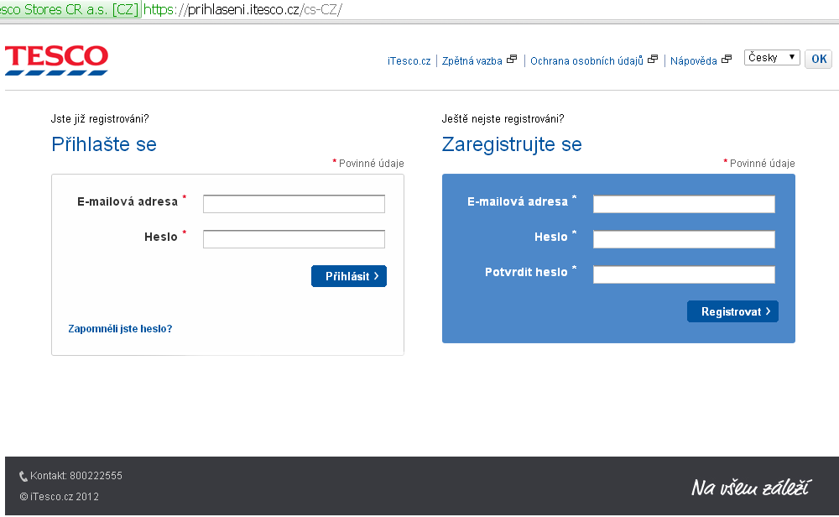
Where does MCA Sit within the Clubcard Site?
Where does MCA Sit in the existing Clubcard Site
How does the customer Journey Look Like?
GHS and MCA

Slide 8
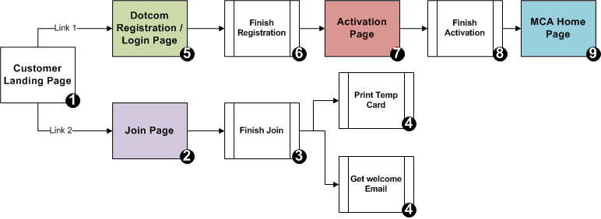
Customer Journey
“one time” activity for MCA (registration)
“one time” activity for MCA
Customers needs to be Registered with GHS before they can start using MCA . This is a “One time” Activity
A MCA Customer already using GHS automatically jumps on to Step 7 from 1 and carries on the rest of the steps to the “MCA Home Page” .
More details in “MCA Registration How to Guide”

Slide 9
GHS and MCA
GHS Login is a Pre-requisite to have MCA Live in any Group county
All Clubcard would use the existing GHS Login to access MCA
User management ( password reset , new user registration would happen via GHS Login)
This is to unify and simplify user management and protect customer data
Customer Landing Page should have two links
For Login / registration ( for Existing clubcard users) this takes us to GHS Page
For Join ( New clubcard customers who wishes to join the scheme) one completion of join customer moves to the Login / Registration link

Slide 10
Stakeholders involved and impacted
Clubcard Team | HSC /UK | Digital Agency | Creative Agency | Helpline | Store Staff | Post
Changed Processes when MCA introduced | CC support, MCA Support, Infra Support, Development and Engineering New Toolset and added WOW | Communication to the customers , Email / SMS | New Set of Soft Images Required for MCA during Every CC campaign | Changed Process and Introduction of new Processes | MCA Awareness ( not to be surprised when they see Soft Vouchers and Coupons ) | Delivery of New and Replacement Clubcard. Dealing with “returns” ( new Process / existing process)

Slide 11
Deep Dive
Topics | Overview
Join , Personal Details , Preferences | Fields , what should be mandatory (should consider import customer) , What fields should be checked for Duplicates , Options that needs to be there for Preferences
Card Delivery / Order Replacement | What is the business stand on Personalized cards , its delivery and replacement cards
Mail Pack Design | For new and replacement cards , Do we need options for replacement ( card , additional cards , cards + key fobs) or should it be standard pack
Coupon / Vouchers images | Do we need Till Coupons to be shown in MCA or should that be only LCM . Engage Image Vendor**
External Links | Links that take you out of the MCA site , Help and FAQ, Legal ( Cookies , email policy , terms and conditions) . Engage Vendor**
Localization | Text , emails , Salutation Required , Currency Positioning , date format required , error text for localization
Schemes and Partner points | Christmas savers ? Do we need that ?
Processes | New and Modified Process , WOW and RACI
Customer Journey | Entry to Exit - Overall Customer journey , Look and feel of the homepage , URL redirections
Pages View / Reporting | Detailed Page by Page /view

Slide 12
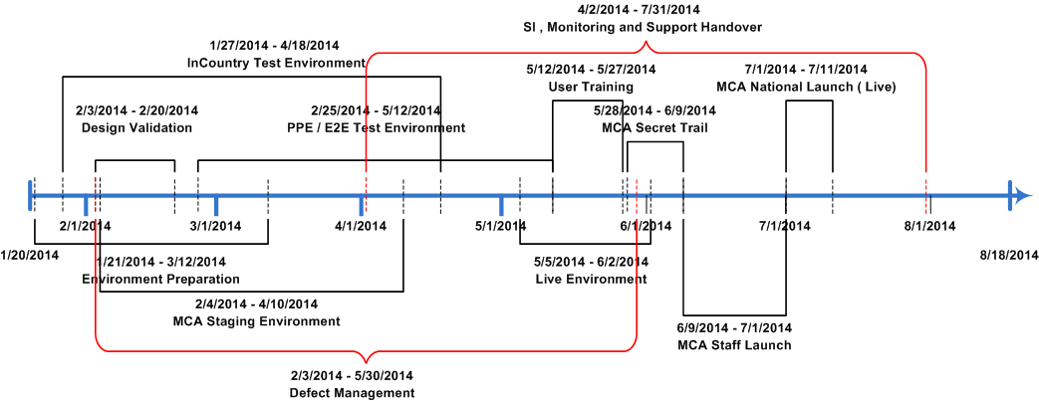
High-level Task and Timelines -CZ
We hope to finish the design validation by the 20th of next month however , Localizations related to Text , emails , date format , currency , Mandatory Fields and Duplicate Checks would be shared in advanced so these can be completed earlier
We need to decide and discuss on the stages in which we go live , Secret , Staff, Customer (or would there be a different approach.
Final Code would be placed in Production by first week of June
We would have 4-5 weeks time from the Code drop in production to Live for customers

Slide 13
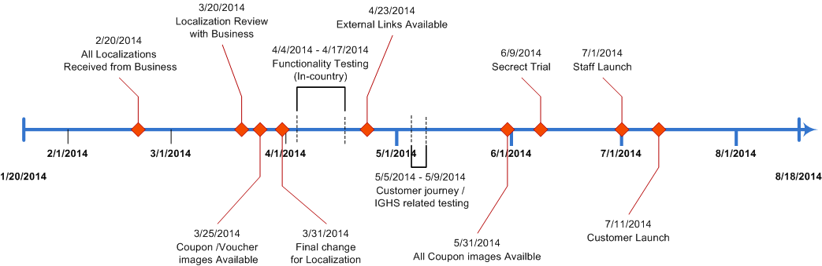
Project Milestone – Business related -CZ
As per Previous Experience in TR it is advisable to engage the Creative agency to get the coupons ,Vouchers and soft clubcard created as well as the Agency to help with external links translations
We plan to have code freeze by 1 week of may after which no changes would be absorbed as it would have a ripple effect on the timelines

Slide 14
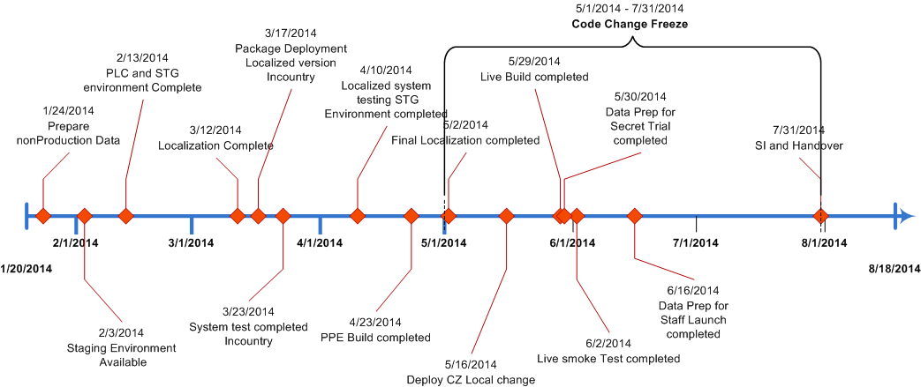
Project Milestones – IT Related -CZ

Slide 15
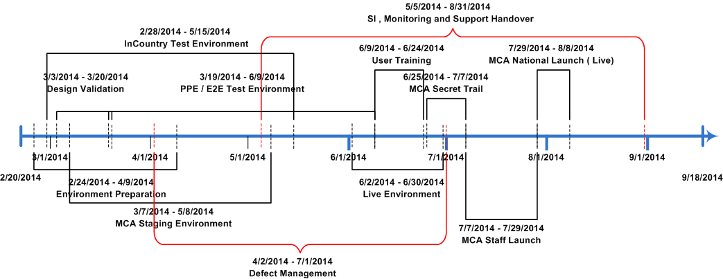
High-level Task and Timelines -SK
We hope to finish the design validation by the 20th of March however , Localizations related to Text , emails , date format , currency , Mandatory Fields and Duplicate Checks would be shared in advanced so these can be completed earlier
We need to decide and discuss on the stages in which we go live , Secret , Staff, Customer (or would there be a different approach.
Final Code would be placed in Production by first week of Aug
We would have 4-5 weeks time from the Code drop in production to Live for customers

Slide 16
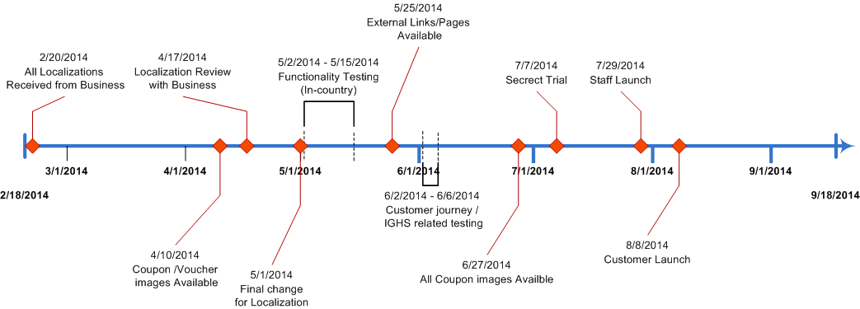
Project Milestone – Business related -SK

Slide 17
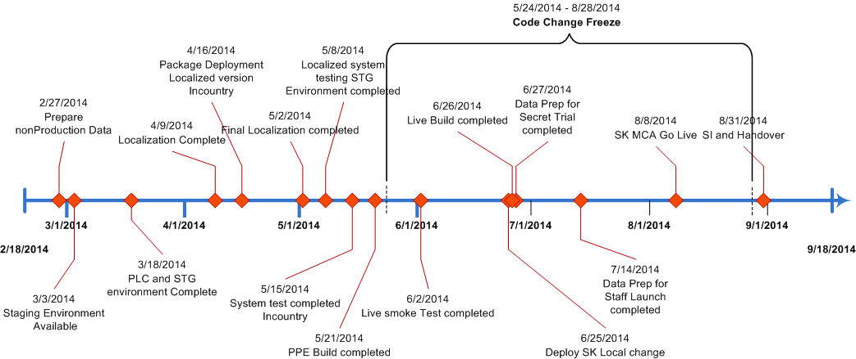
Project Milestones – IT Related -SK

Slide 18
Testing Strategy
Environment | Type | Involvement | What we Test
In Country / Staging / PPE | System Test | Project | Smoke test on Functionalities
In Country | Functional | Project + Business | 1.Localization on Various Scenarios 2. Issuance (C@T/LCM/Vouchers) 3. Redemptions ( Coupons / Vouchers) 4. Online Join 5. Online Print (Coupon / vouchers/ Clubcard) 6. Data update 7. Mandatory and Duplicity Checks 8. Customer types, Individuals , Associate , Merged accounts
Dotcom Staging | Localization | Project + Business | 1.Final Localization Checks 2. External Links
Dotcom PPE | Functional | Project + Business | 1.E2E Join Cycle 2. Dotcom Registration Login and Activation 3. Password Reset 4. External Links

Slide 19
Next Steps
Send Text to be localized - Project
Questioner for other Variables - Project

Slide 20
Děkuji vám!

